Slide 1

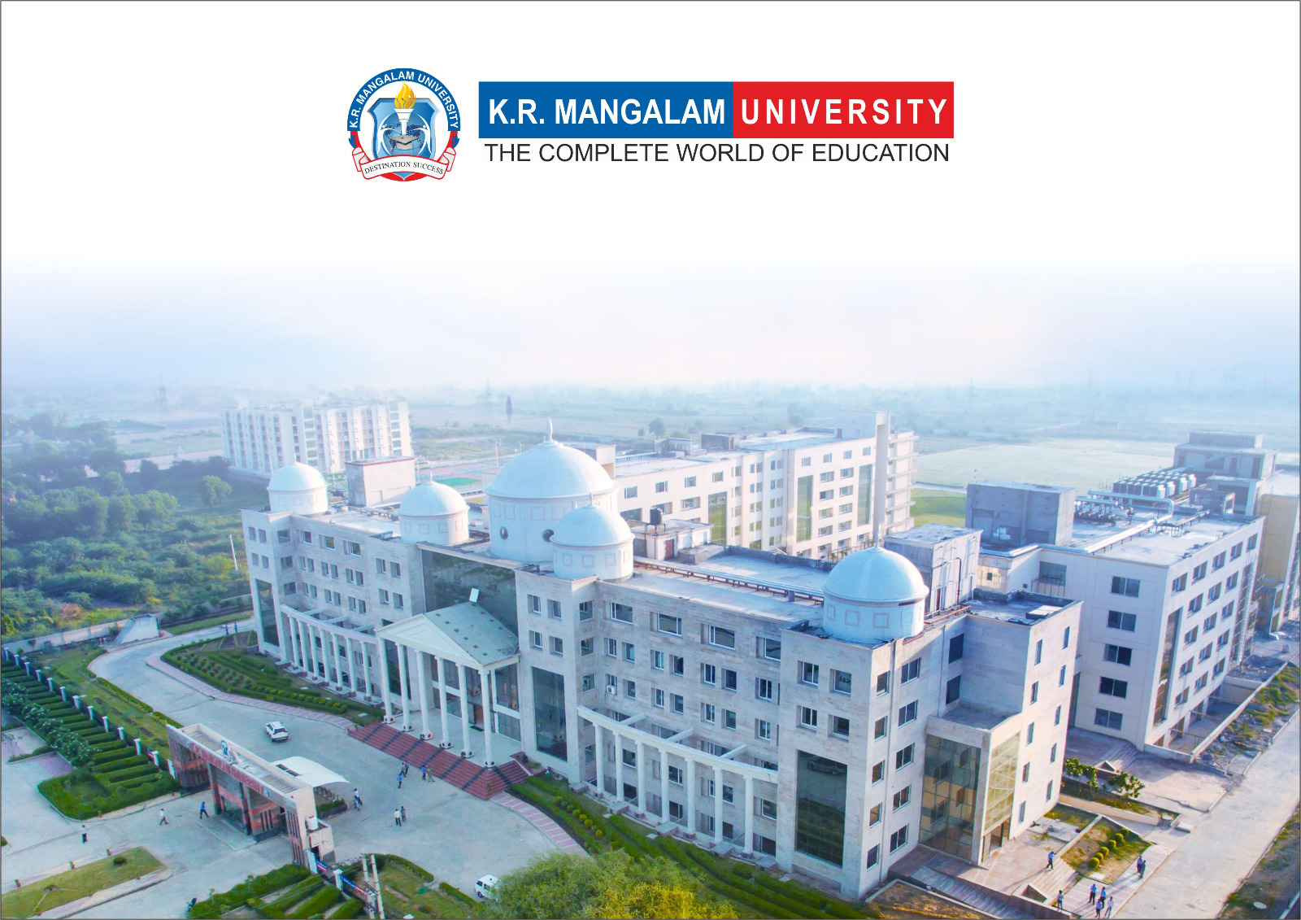
Course Code: ETCCCH104
Course Name: Engineering Chemistry
Program: B.Tech
Dr Deepak Yadav
Assistant Professor, Department of Chemistry
School of Basic and Applied Sciences
K.R. Mangalam University
Sohna Road, Gurugram

Slide 2
Conducting and Biodegradable polymers

Slide 3
Session Outcomes
Explain the concept of conducting polymers and their mechanism of conduction.
Differentiate between intrinsic and extrinsic conducting polymers.
Understand the concept of biodegradable polymers and their importance.
Identify real-world applications of both types.

Slide 4
Introduction to Conducting Polymers
Polymers generally act as insulators.
Some polymers can conduct electricity due to conjugated double bonds or doping.
They are called Conducting Polymers.
Types of Conducting Polymers
Intrinsically Conducting Polymers (ICPs):
Have conjugated π-electron systems.
e.g., Polyacetylene, Polyaniline, Polypyrrole.
Extrinsically Conducting Polymers:
Conductivity due to blending with conductive fillers (graphite, carbon black, metal particles).

Slide 5
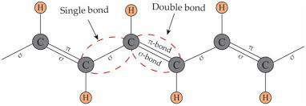
Mechanism of Conduction
Alternating single and double bonds (conjugation) allow delocalization of electrons.
Doping with electron donors/acceptors increases conductivity.

Slide 6
Examples of Conducting Polymers
Polyacetylene – first discovered conducting polymer.
Polyaniline – stable, cheap, widely studied.
Polypyrrole – good environmental stability.
Polythiophene – used in sensors and electronics.
Applications of Conducting Polymers
Rechargeable batteries.
Solar cells, light-emitting diodes (LEDs).
Antistatic coatings.
Sensors & actuators.
Flexible electronic devices.

Slide 7
Biodegradable Polymers
Polymers that decompose by microorganisms into CO₂, H₂O, and biomass
Environmentally friendly → reduce plastic pollution.
Classification of Biodegradable Polymers
Natural Biodegradable Polymers:
Starch, Cellulose, Proteins, Polyhydroxybutyrate (PHB).
Synthetic Biodegradable Polymers:
Polylactic acid (PLA), Polyglycolic acid (PGA), Polycaprolactone (PCL).

Slide 8
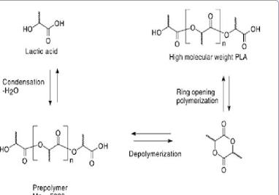
Preparation of Biodegradable Polymers
Polylactic acid (PLA): Polymerization of lactic acid.
Polyglycolic acid (PGA): Polymerization of glycolic acid.
PHBV (Polyhydroxybutyrate-co-valerate): Produced by bacterial fermentation of sugars.

Slide 9
Properties of Biodegradable Polymers
Non-toxic, eco-friendly.
Biocompatible (safe inside body).
Moderate mechanical strength.
Decompose under natural conditions (sunlight, moisture, microbes).
Applications of Biodegradable Polymers
Medical field:
Surgical sutures, drug delivery systems, tissue engineering.
Packaging industry:
Biodegradable bags, films, bottles.
Agriculture:
Mulch films, controlled release fertilizers.

Slide 10
Comparison Table
Property | Conducting Polymers | Biodegradable Polymers
Nature | Conduct electricity | Break down naturally
Mechanism | Conjugated bonds & doping | Microbial/chemical degradation
Examples | Polyacetylene, Polyaniline | PLA, PGA, PHB, PHBV
Applications | Electronics, sensors | Packaging, medical implants

Slide 11
Takeaway of Session
Conducting polymers: conjugated systems, useful in electronics & energy storage.
Biodegradable polymers: eco-friendly, essential in medicine & packaging.
Both represent future directions in material science:
Sustainable materials.
Green technology.
Advanced electronics.

Slide 12
Q1. Polyacetylene conducts electricity due to: a) Ionic bonds b) Conjugated double bonds c) Cross-linking d) Hydrogen bonding
Q2. Which is a biodegradable polymer? a) Polyvinyl chloride (PVC) b) Polylactic acid (PLA) c) Polystyrene d) Polyethylene
Q3. Polyaniline is an example of: a) Biodegradable polymer b) Conducting polymer c) Thermosetting plastic d) Elastomer
Q4. PHBV is obtained by: a) Free radical polymerization b) Bacterial fermentation c) Condensation reaction d) Addition reaction

Slide 13
Thank You

